Slide 1






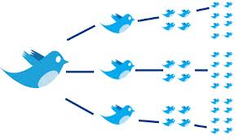


USER GENERATED CONTENT ANALYTICS Fall 2018 Sessions 1 & 2, 08/30, 09/04
Dr. Anitesh Barua
David Bruton Jr. Centennial Chair Professor of Business
Distinguished Fellow, INFORMS Information Systems Society
Stevens Piper Foundation Professor
University of Texas Distinguished Teaching Professor
Associate Director, Center for Research in e-Commerce
McCombs School of Business, University of Texas at Austin
Email: aniteshb@gmail.com

Slide 2
Before and After this Course
Do you know how to | Yes/No
Extract tweets with detailed user info including location & other attributes?
Extract conversations in online forums, blogs, Youtube, etc.?
Analyze unstructured data to generate new business insights and discover facts?
Leverage the wisdom of the crowd to create new products/services?
Analyze consumer sentiments using supervised and unsupervised methods?
Predict business outcomes (e.g., sales) from social data
Assess resonance between a message (e.g., a campaign) & response?
Find influencers in social media?
Leverage the power of images in making business predictions?
Copyright Anitesh Barua 2018

Slide 3
Tools to Collect & Analyze Social Mentions
Strongly recommend PythonAnywhere.com (cloud service)
$5/month, may be able to get it for $1/month
No need to install Python on your computer
Faster processing (compared to the average laptop)
Data collection tools: Python scripts for Twitter, WebScraper for most sites (e.g., Yelp.com, TripAdvisor.com, etc.), Youtube scraper, etc.
Social network analysis tools: NodeXL, Gephi, Networkx, etc.
Analyses & visualization: Custom python scripts
Sentiment analysis tools: SentiStrength, custom Python scripts
Text analytic tools (for classification & prediction): LightSIDE, custom Python scripts
Copyright Anitesh Barua 2018

Slide 4
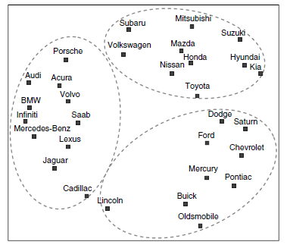
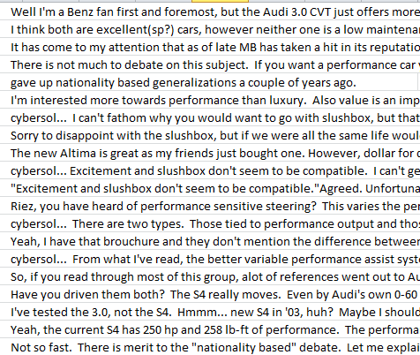
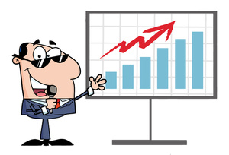



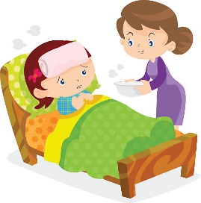
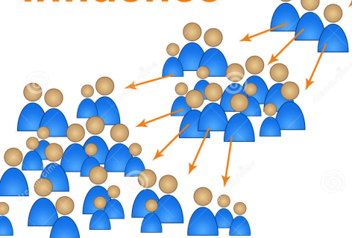
The Untapped Potential of User Generated Content
Obtain insights:
Analyze brand
& product
associations
Predict:
E.g., salesrank,
retention, spend,
etc.
Metrics, metrics & more metrics
Create new
products/services
Who matter most:
Find influencers
Copyright Anitesh Barua 2018

Slide 5
User Generated Content
Once there were only numbers (e.g., demographic, sales, etc.)
But big data would not be big with just numbers
How did User Generated Content (UGC) contribute to the 4 Vs of big data?
~ 80% of UGC today generated by social media
And the rest 20% are?
Copyright Anitesh Barua 2018

Slide 6
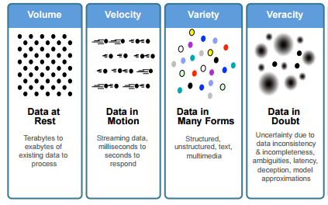
The Vs of Big Data (Revisited)
What has social got to do with the Vs of big data?
Source: IBM

Slide 7
But When Machines Write Fake Reviews …
1. Easily my favorite Italian restaurant. I love the taster menu, everything is amazing on it. I suggest the carpaccio and the asparagus. Sadly it has become more widely known and becoming difficult to get a reservation for prime times.
2. My family and I are huge fans of this place. The staff is super nice and the food is great. The chicken is very good and the garlic sauce is perfect. Ice cream topped with fruit is delicious too. Highly recommended!
3. I come here every year during Christmas and I absolutely love the pasta! Well worth the price!
4. Excellent pizza, lasagna and some of the best scallops I've had. The dessert was also extensive and fantastic.
5. The food here is freaking amazing, the portions are giant. The cheese bagel was cooked to perfection and well prepared, fresh & delicious! The service was fast. Our favorite spot for sure! We will be back!
6. I have been a customer for about a year and a half and I have nothing but great things to say about this place. I always get the pizza, but the Italian beef was also good and I was impressed. The service was outstanding. The best service I have ever had. Highly recommended.
1 is real, 2 is fake, 3 and 4 are real, and 5 and 6 are fake.

Slide 8
Examples of What UGC Can Do
Novel sources of data
Publicly available home search data predicted changes in home prices better than forecasts of National Association of Realtors
Data from GoogleTrends & Twitter could predict flu-related ER visits long before CDC issued advisory.
Predict sales of new products much better than traditional forecasting models
What are the general business implications?
Source: McAfee & Brynjolfsson

Slide 9
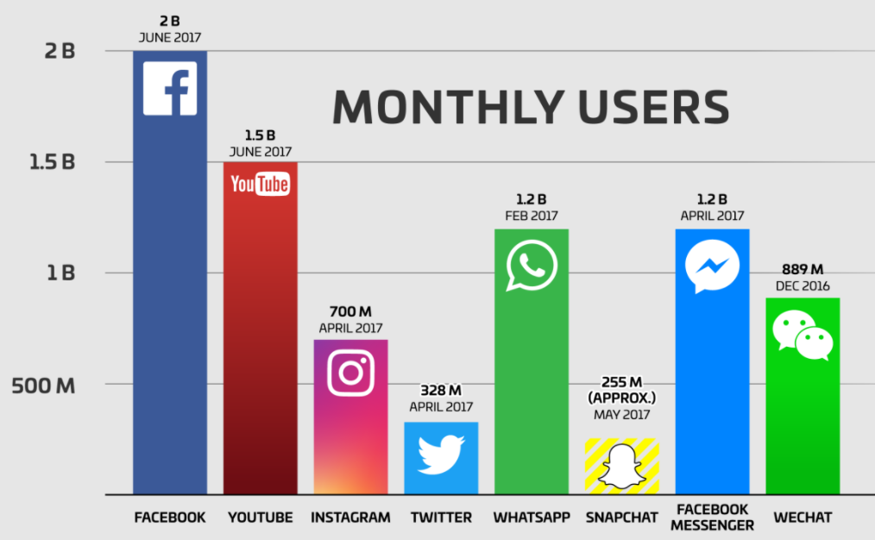
Why Bother About Text?
Web pages, online conversations/posts, digital libraries, etc.
Twitter: 500 million daily tweets
FB: 4.75 billion pieces of content shared daily
Conversations in online forums

Slide 10

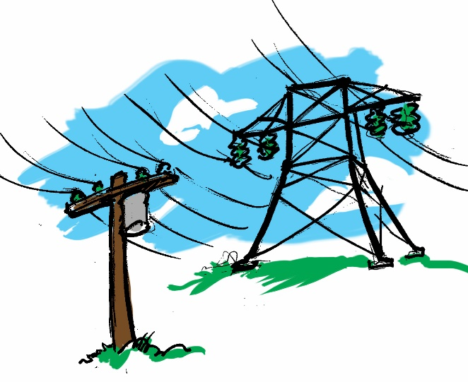
Business Applications With Unstructured Big Data
Healthcare
Which CHF patients will be readmitted?
Free-form inputs (text) about lifestyle most important predictor
Electric grid failures
Traditional models
Enriching with text
Copyright Anitesh Barua, 2018

Slide 11
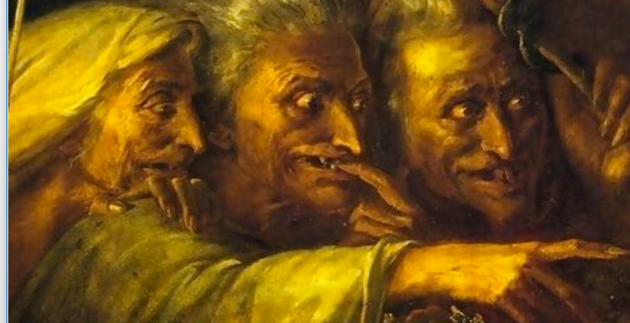
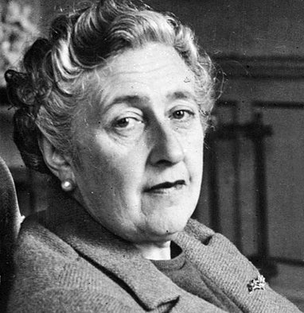
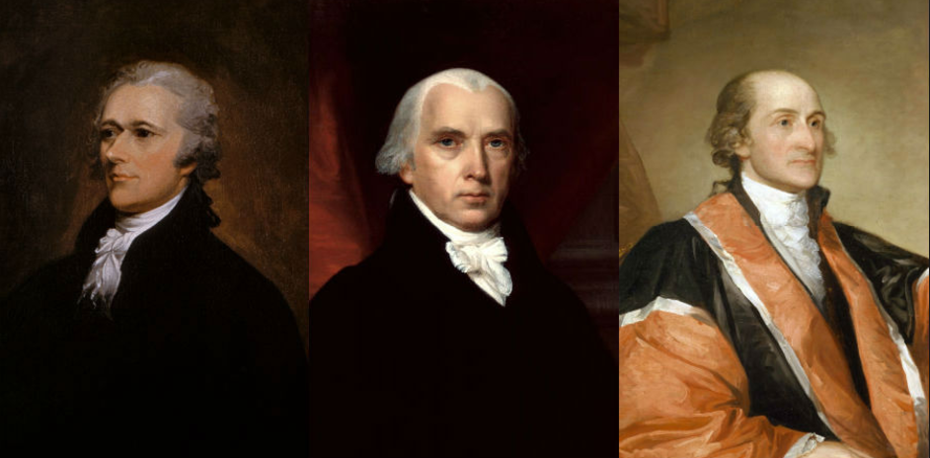
Innovative Applications Outside of Business Domain
Literature
Who wrote Macbeth?
When did Agatha Christie develop Alzheimer’s?
History
Who wrote the Federalist papers?
https://www.lexalytics.com/lexablog/2015/who-wrote-macbeth-3-things-text-mining-can-tell-us-about-authors

Slide 12
Pros & Cons of Online Social Data
Pros (relative to a survey) | Cons | Mitigation?

Slide 13
A 50k Feet Overview of User Generated Content Analytics

Slide 14
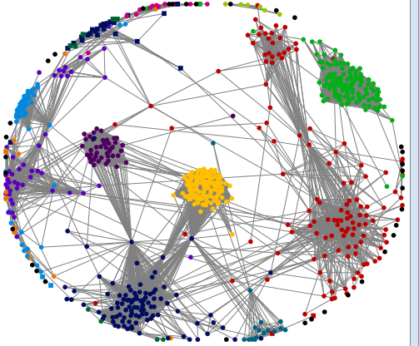
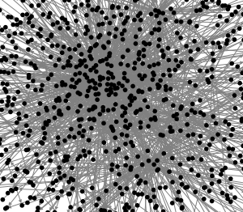

1. “Democratization of the Lady Gaga Effect”
From channels to platforms
Conversations are now visible
Key themes, sentiments, attention,
influence, etc. can be measured
Copyright Anitesh Barua 2018

Slide 15
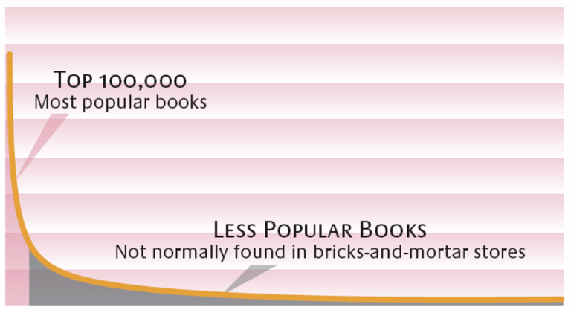
2. The Long Tail* & Social Media
Effect of the Internet
Sales
High Popularity Low
Customer preferences are diverse & revealed in social chatter
New opportunities for push strategies, word-of-mouth & social influence
Not feasible if you have one-size-fits-all business strategy
Copyright Anitesh Barua, 2018
*Image Source: Brynjolfsson, Hu and Smith; *Chris Anderson

Slide 16
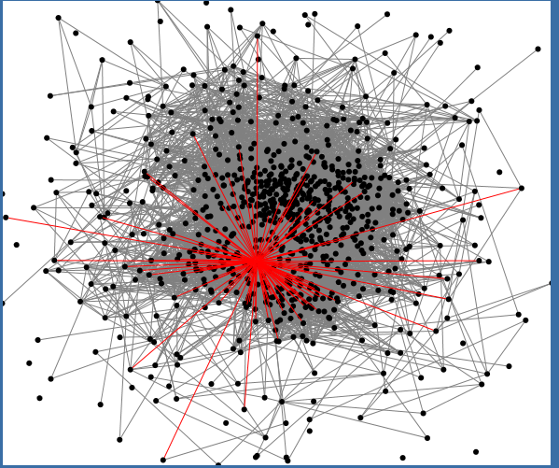
3. Your Network Location Matters Too
Who are most popular?
Who are “best” connected?
Who can help spread a message?
Who can help connect diverse groups?
Who’s that guy?
Copyright Anitesh Barua 2018

Slide 17
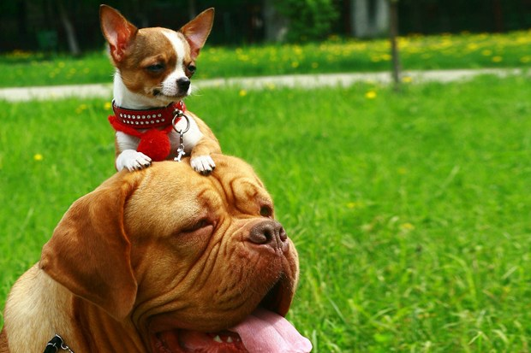
4. The Network Value of a Customer
From Customer Lifetime Value (CLV) to Customer Influence Value (CIV)
Customer Network Lifetime Value (CNLV) = CLV + CIV
Copyright Anitesh Barua 2018
Image Source: http://www.wired.co.uk/news/archive/2012-08/13/customer-network-lifetime-value

Slide 18

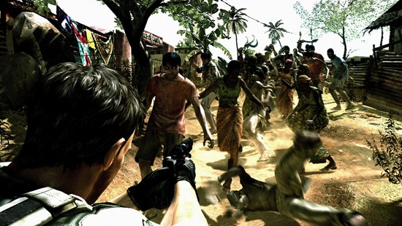
Where is the Social ROI?
Can social or digital Word-of-Mouth (WOM) ROI be higher than that of Web 1.0
(e.g., paid search)?
What kind of incentives are required for spreading the word in social networks?
How can we measure social ROI?
Copyright Anitesh Barua 2018

Slide 19
5. Monitoring & Visualization Through Social Media
Unprecedented real time visibility into
Public reactions
Emerging phenomena or events
Customer preferences
Copyright Anitesh Barua 2018

Slide 20
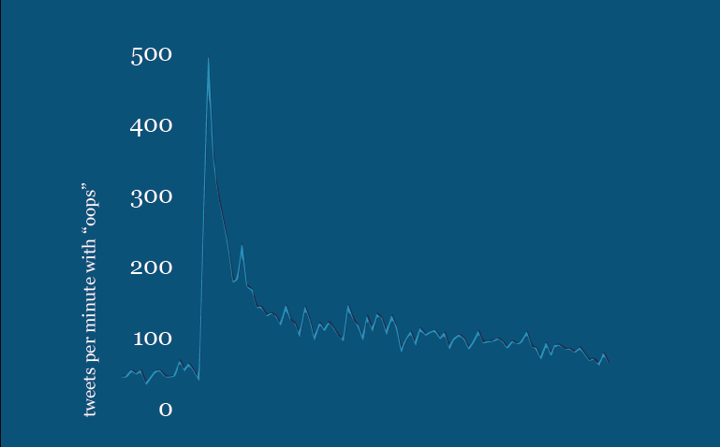
Real-time Assessment of Sentiment & Opinion: The “Oops” Tweets
Source: April Underwood, Twitter

Slide 21
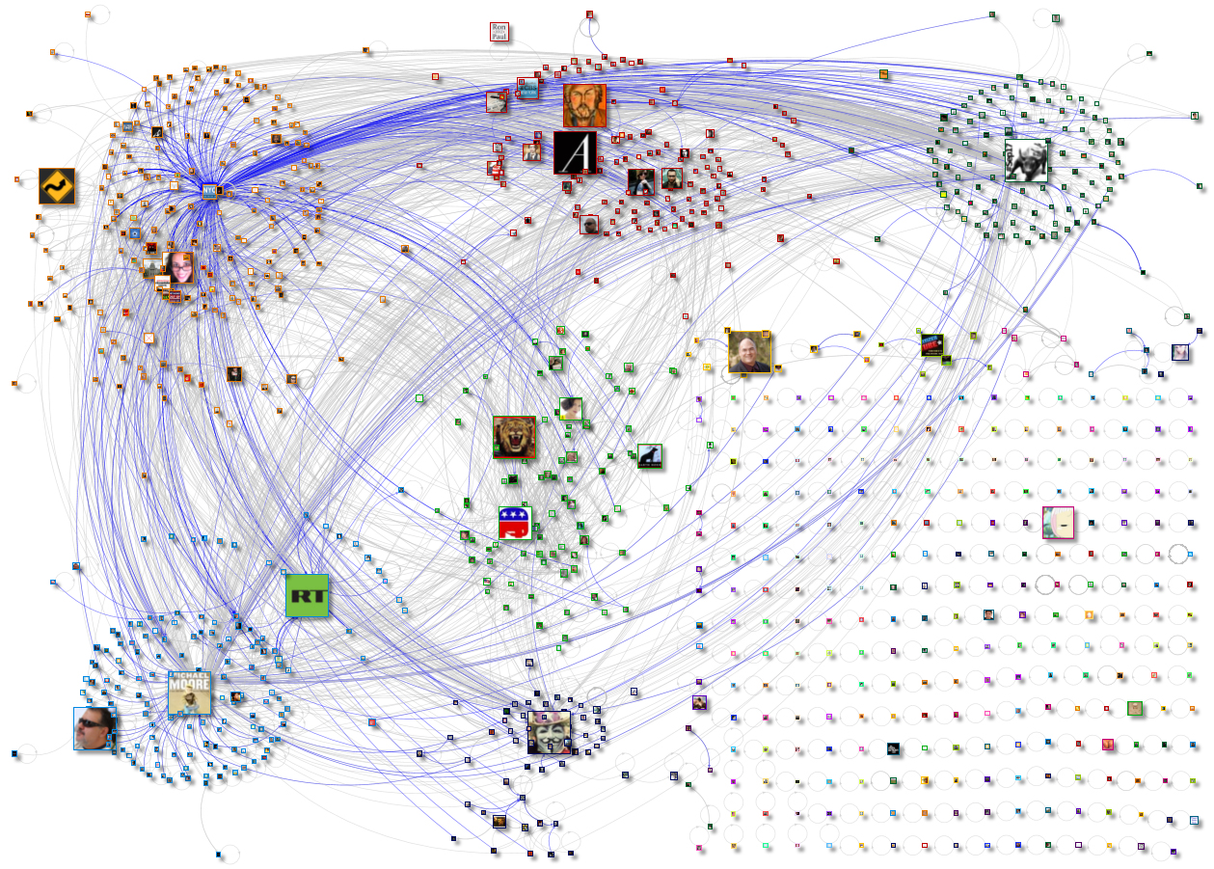
Tweets, Re-tweets: What do They Say?
Source: www.newscientist.com

Slide 22
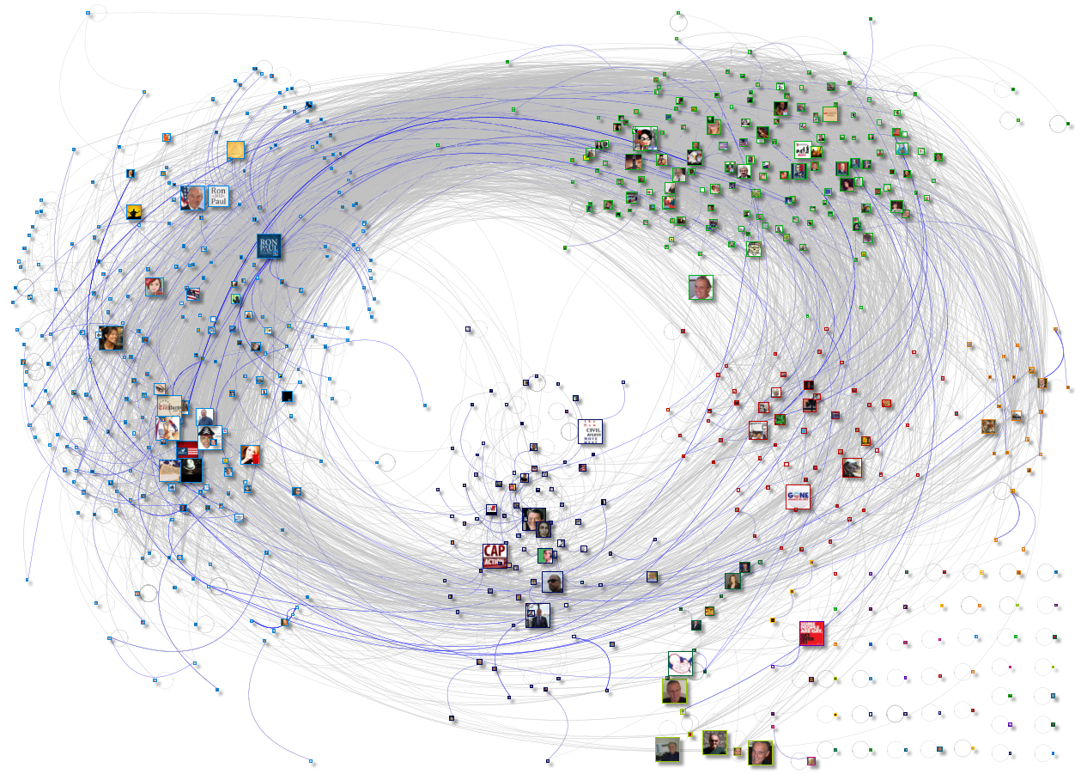
How is This Different From the Previous Network?
Source: www.newscientist.com

Slide 23
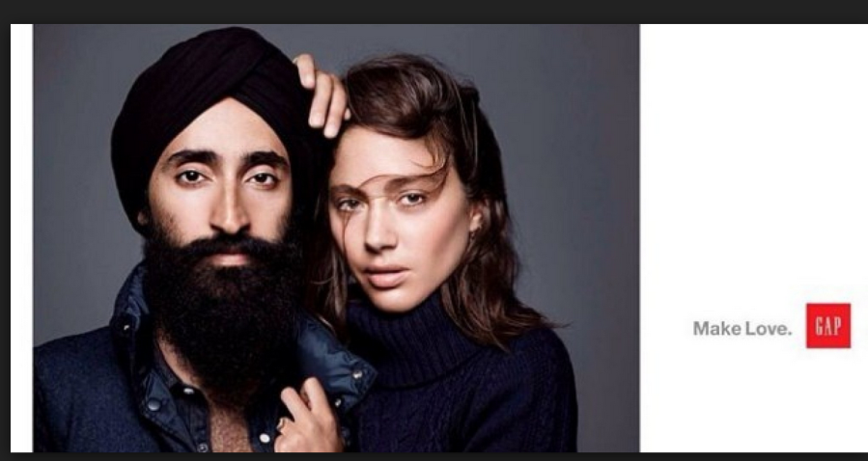
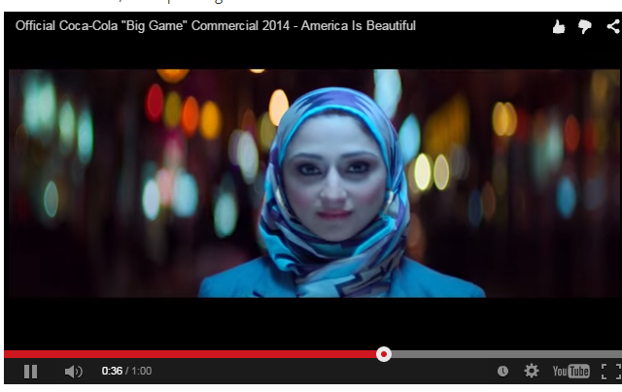
6. Knowledge Discovery from Social Media
User generated content (UGC) can reveal new insights about brands, products & events
E.g., do people associate Uber with lack of safety?
To what extent did consumers associate Gap (or Coke) with diversity after their unique ads?
Copyright Anitesh Barua 2018

Slide 24
7. Can We Predict Business Outcomes from Social Mentions?
E.g., use sentiment, key themes, volume, etc. to predict
Brand switching
Customer ratings & recommendation
Box office revenues
Stock price movements
Inventory requirements
Need suitable metrics
Copyright Anitesh Barua 2018

Slide 25
Takeaways
Platform based conversations create new opportunities for business
Observe, engage & discover
Not just ‘a’ customer but customers embedded their social networks
Individual CLV to CIV and CNLV
Uniqueness of social data and new methods to visualize, explore and analyze
Copyright Anitesh Barua 2018

